Slide 1
Mobile Sensors Support in Android Platform
Presented by: Soha Ahmed & Shaimaa Saied.

Slide 2
Agenda
What are sensors?
Sensor types.
Sensor categories.
Sensor accessibility.
Android sensor framework.
Handling different sensor configuration.
Best Practices for Accessing & using sensors.

Slide 3
Sensors
capable of providing raw data with high precision and accuracy.
Hardware/software.
Accessible by using the Android sensor framework.

Slide 4
Sensor Types
Hardware sensors: They are physical components That derive their data by directly measuring specific environmental properties, such as acceleration, geomagnetic field strength, or angular change. Examples: Gyroscope sensor, acceleration sensor.
Software sensors: They derive their data from one or more of the hardware-based sensors. Examples: Linear acceleration sensor, the gravity sensor.

Slide 5
Sensor Categories
Motion sensors: These sensors measure acceleration forces and rotational forces along three axes. This category includes accelerometers, gravity sensors, gyroscopes, and rotational vector sensors.
Environmental sensors : These sensors measure various environmental parameters, such as ambient air temperature and pressure, illumination, and humidity. This category includes barometers, photometers, and thermometers.
Position sensors: These sensors measure the physical position of a device. This category includes orientation sensors and magnetometers.

Slide 6
Sensor Types
Sensor | Type | Description | Common Uses
TYPE_ACCELEROMETER | Hardware | Measures the acceleration force in m/s² that is applied to a device on all three physical axes (x, y, and z), including the force of gravity. | Motion detection (shake, tilt, etc.).
TYPE_AMBIENT_TEMPERATURE | Hardware | Measures the ambient room temperature in degrees Celsius (°C). See note below. | Monitoring air temperatures.
TYPE_GRAVITY | Software or Hardware | Measures the force of gravity in m/s² that is applied to a device on all three physical axes (x, y, z). | Motion detection (shake, tilt, etc.).
TYPE_GYROSCOPE | Hardware | Measures a device's rate of rotation in rad/s around each of the three physical axes (x, y, and z). | Rotation detection (spin, turn, etc.).
TYPE_LIGHT | Hardware | Measures the ambient light level (illumination) in lx. | Controlling screen brightness.
TYPE_LINEAR_ACCELERATION | Software or Hardware | Measures the acceleration force in m/s² that is applied to a device on all three physical axes (x, y, and z), excluding the force of gravity. | Monitoring acceleration along a single axis.
TYPE_MAGNETIC_FIELD | Hardware | Measures the ambient geomagnetic field for all three physical axes (x, y, z) in μT. | Creating a compass.

Slide 7
Sensor Accessibility
Sensors can be accessed on the device and raw sensor data can be acquired using the Android sensor framework.
The sensor framework provides several classes and interfaces that help you perform a wide variety of sensor-related tasks. For example, you can use the sensor framework to do the following:
Determine which sensors are available on a device.
Determine an individual sensor's capabilities, such as its maximum range, manufacturer, power requirements, and resolution.
Acquire raw sensor data and define the minimum rate at which you acquire sensor data.
Register and unregister sensor event listeners that monitor sensor changes.

Slide 8
Android Sensor Platform
is part of the android.hardware package and includes the following classes and interfaces:
1- Sensor Manager : To create an instance of the sensor service. This class provides various methods for accessing and listing sensors, registering and unregistering sensor event listeners, and acquire orientation information.
-Java example:
1. private SensorManager mSensorManager; 2. mSensorManager =(SensorManager)getSystemService(Context.SENSOR_SERVICE);
3. List<Sensor> deviceSensors = mSensorManager.getSensorList(Sensor.TYPE_ALL);
3. List<Sensor> deviceSensors = mSensorManager.getSensorList(Sensor.TYPE_Gravity);
4. mSensorManager.getDefaultSensor(Sensor.TYPE_MAGNETIC_FIELD)
Notes:
getDefaultSensor:If a device has more than one sensor of a given type, one of the sensors must be designated as the default sensor. If a default sensor does not exist for a given type of sensor, the method call returns null

Slide 9
Android Sensor Platform
2- Sensor: Use this class to create an instance of a specific sensor. This class also provides methods that lets you determine a sensor’s capabilities.
-Java example:
1. private SensorManager mSensorManager;
2. private Sensor mSensor; mSensor = null;
3. mSensorManager =(SensorManager)getSystemService(Context.SENSOR_SERVICE);
4. if (mSensorManager.getDefaultSensor(Sensor.TYPE_GRAVITY) != null){
List<Sensor> gravSensors = mSensorManager.getSensorList(Sensor.TYPE_GRAVITY); 6. for(int i=0; i<gravSensors.size(); i++) { 7. if ((gravSensors.get(i).getVendor().contains("Google LLC")) && 8. (gravSensors.get(i).getVersion() == 3)){ // Use the version 3 gravity sensor. 9. mSensor = gravSensors.get(i);
10. break;}}

Slide 10
Android Sensor Platform (Sensor class)
Another useful method is the getMinDelay() method, which returns the minimum time interval (in microseconds) a sensor can use to sense data.
Notes:
Another useful method is the getMinDelay() method, which returns the minimum time interval (in microseconds) a sensor can use to sense data. Any sensor that returns a non-zero value for the getMinDelay()method is a streaming sensor. Streaming sensors sense data at regular intervals and were introduced in Android 2.3 (API Level 9). If a sensor returns zero when you call the getMinDelay() method, it means the sensor is not a streaming sensor because it reports data only when there is a change in the parameters it is sensing.

Slide 11
Android Sensor Platform
3- Sensor Event: The system uses this class to create a sensor event object, which provides information about a sensor event. This object includes:
raw sensor data.
the type of sensor that generated the event
the accuracy of the data
the timestamp of the event.
4- Sensor Event Listener: This interface can be used to create two callback methods that receive notifications (sensor events) when the sensor values change or sensor accuracy changes.

Slide 12
Monitoring Sensor Events
To monitor raw sensor data you need to implement two callback methods that are exposed through the SensorEventListener interface: onAccuracyChanged() and onSensorChanged(). The Android system calls these methods whenever the following occurs:
A sensor's accuracy changes.In this case the system invokes the onAccuracyChanged() method, providing you with a reference to the Sensorobject that changed and the new accuracy of the sensor. Accuracy is represented by one of four status constants:SENSOR_STATUS_ACCURACY_LOW, SENSOR_STATUS_ACCURACY_MEDIUM, SENSOR_STATUS_ACCURACY_HIGH, or SENSOR_STATUS_UNRELIABLE.

Slide 13
Monitoring Sensor Events
A sensor reports a new value.In this case the system invokes the onSensorChanged() method, providing you with a SensorEvent object. A SensorEvent object contains information about the new sensor data, including: the accuracy of the data, the sensor that generated the data, the timestamp at which the data was generated, and the new data that the sensor recorded.

Slide 14
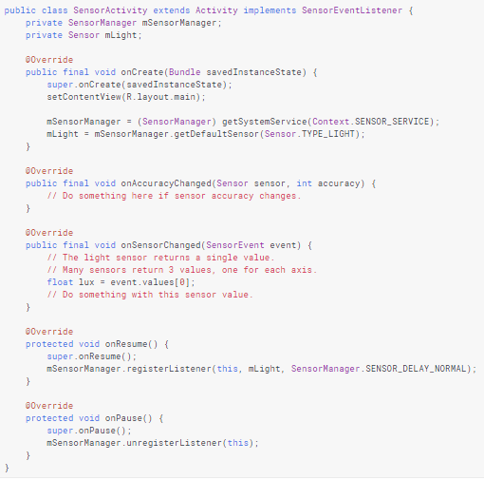
Android Sensor Platform

Slide 15
Handling Different Sensor Configuration
Android does not specify a standard sensor configuration for devices, which means device manufacturers can incorporate any sensor configuration that they want in their Android-powered devices.
As a result, devices can include a variety of sensors in a wide range of configurations. If an application relies on a specific type of sensor.
The owner of the application has to ensure that the sensor is present on a device of it to run successfully.
You have two options for ensuring that a given sensor is present on a device:
Detect sensors at runtime and enable or disable application features as appropriate.
Use Google Play filters to target devices with specific sensor configurations.

Slide 16
Detecting Sensors at Runtime
If your application uses a specific type of sensor, but doesn't rely on it, you can use the sensor framework to detect the sensor at runtime and then disable or enable application features as appropriate. For example the pokemon Go.
private SensorManager mSensorManager; ... mSensorManager = (SensorManager) getSystemService(Context.SENSOR_SERVICE); if (mSensorManager.getDefaultSensor(Sensor.TYPE_PRESSURE) != null){ // Success! There's a pressure sensor. } else { // Failure! No pressure sensor. }

Slide 17
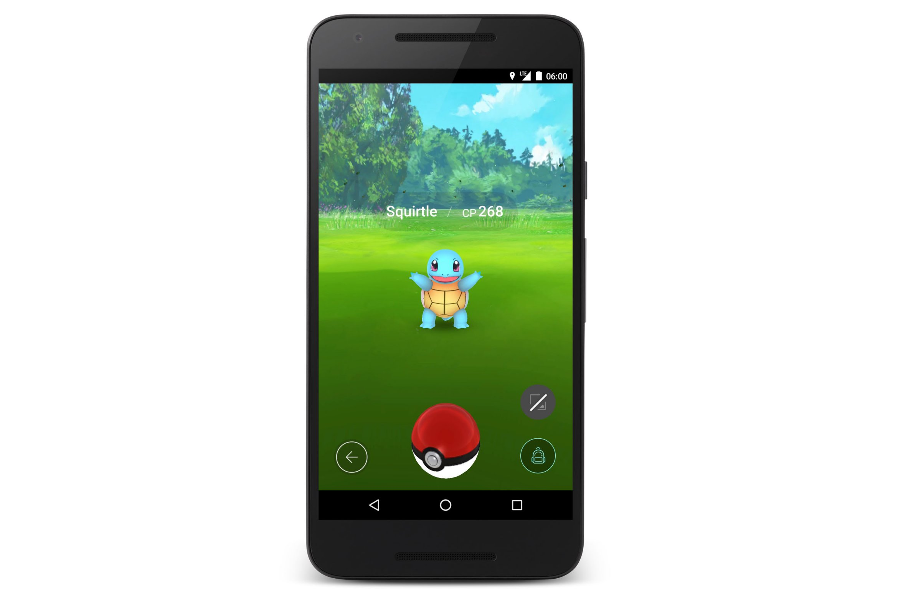
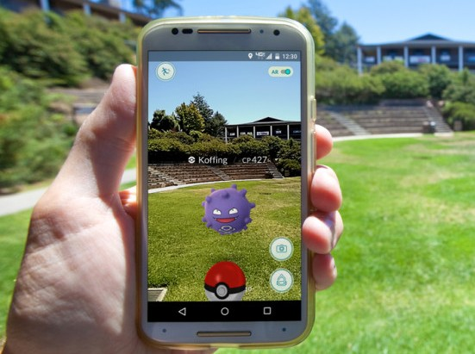
Pokemon Go Example
Without Gyroscope or accelerometer
With all sensors needed

Slide 18
Using Google Play Filters
If an application gets published on Google Play and it need specific sensors to be able to operate, developers can use the <uses-feature> element in the manifest file to filter the application from the device that do not have the appropriate sensor configuration for the application.
The <uses-feature> element has several hardware descriptors to filter applications based on the presence of specific sensors. Example :-
<uses-feature android:name=”android.hardware.sensor.accelerometer” Android:required=”true” />

Slide 19
Using Google Play Filters
If this element and descriptor is added to the application’s manifest, users will see the application on Google Play only if their device has an accelerometer.
The descriptor should be set to Android:required=”true” only if the application relies entirely on a specific sensor. If the application uses a sensor for some functionality but still operates without the sensor, then the sensor should be listed in the <uses-feature> element.
the descriptor should be set to android:required=”false”. This helps ensure that the device can install the application even if they don’t have that particular sensor.

Slide 20
Best Practices for Accessing & using sensors
Only gather sensor data in the foreground.
On devices running android 9 (codename is “pie”) or higher, apps running in the background have the following restrictions:
Sensors that use continuous reporting mode, such as accelerometer and gyroscopes, don’t receive events, so it will be useless to try to gather sensor data when it’s in the background.

Slide 21
Best Practices for Accessing & using sensors
Unregister sensor listeners
Be sure to unregister a sensor’s listener when you are done using the sensor or when the sensor activity pauses. If a sensor listener is registered and it’s activity is paused, the sensor will continue to acquire data and use battery resources unless you unregister the sensor. The following code shows how to use the onPause() method to unregister a listener:-
Private SensorManager mSensorManager;
@Override
Protected void onPause() {
Super.onPause();
MSensorManager.unregisterListener(this);
}

Slide 22
Best Practices for Accessing & using sensors
Test with the Android Emulator
The Android Emulator includes a set of virtual sensor controls that allow you to test sensors such as accelerometer, ambient temperature, proximity, light and others.
The emulator uses a connection with an Android device, it monitors changes in the sensors on the device and transmits them to the emulator. The emulator is then transformed based on the new values that it receives from the sensors on your device.

Slide 23
Best Practices for Accessing & using sensors
Verify sensors before you use them
Always verify that a sensor exists on a device before you attempt to acquire data from it. Don't assume that a sensor exists simply because it's a frequently-used sensor. Device manufacturers are not required to provide any particular sensors in their devices.

Slide 24
Best Practices for Accessing & using sensors
Choose sensor delays carefully
When you register a sensor with the registerListener() method, be sure you choose a delivery rate that is suitable for your application or use-case. Sensors can provide data at very high rates. Allowing the system to send extra data that you don't need wastes system resources and uses battery power.

Slide 25
Refrences:
https://developer.android.com/guide/topics/sensors
http://www.futuretechnology500.com/index.php/augmented-reality/pokemon-go-ar-game-could-start-social-environmental-revolution/

Slide 26
Any questions?

Slide 27
Thank you

